Slide 1
Ethical Hacking – Lecture 15
John Black Fall 2020

Slide 2
The Browser Side
Browsers use a UI and a “layout engine”
The UI has the URL window, history control, preferences, options, etc., and it embeds the layout engine
The layout engine takes a URL and a graphical rectangle and basically turns a URL into a rendered page
So it handles loading of files (images, movies, text, HTML), cookies, links, all scripting, plug-ins, etc.
The layout engine is the real workhorse in the browser
The nice thing about this modularity is that layout engines can be embedded in other apps too

Slide 3
Common Layout Engines
Trident (IE)
Embedded in Outlook to support HTML in email, also in RealPlayer, Winamp mini-browsers
Presto (Opera)
KHTML (KDE, Open-source)
Konquerer, forked to Webkit
Used in Chrome and Safari, and Kindle browser
Gecko (Mozilla, Open-source)
Firefox, Thunderbird (email), SeaMonkey

Slide 4
Web 1.0 vs 2.0
In 1991 everything was text, static HTML, and images
And things were actually more secure!
Starting around 2011 we added a ton of stuff to the browser
HTML5
XML support, stricter markup rules, video/audio tags
Scripting
Javascript, VBScript
Layout
CSS, XSL
Plug-ins
Acrobat reader, Flash, media players, tons more
Web 1.0: my homepage
Web 2.0: DVWA

Slide 5
HTML Tutorial
Prereq for this class, so we’re not doing it
I would guess that everyone knows the basics anyway?!
I put a tutorial link on our page
Probably the most important part of basic HTML for our purposes is forms
<form action="/formprocessingscript.php" method="post">
<div>House number: <input type="text" name="housenumber" /></div>
<div>Street: <input type="text" name="street" /></div>
<div><input type="submit" value=“Go!”/></div> </form>

Slide 6
HTML Forms
Can do radio buttons, checkboxes, dropdowns, text fill-in, password fields (automatically obscured), textareas, etc
Form fields can be hidden
Sometimes used in preference to cookies for keeping state
No filtering is done by default
We have to add Javascript (to filter on the browser-side, which is faster)
Or server-side filters (which is slower but more secure)

Slide 7
Encodings
Since HTTP and HTML are text-based, they have support encodings for various symbols
URLs must be ASCII (0x20-0x7e), but several symbols have special meaning in URLs or HTTP, so they’re often encoded
Ex: %3d =, %25 %, %20 <space>, %0a <newline>, %00 <null>, + <space>, etc
If we are attacking a web-app and want to pass special chars as data, then encode as above; if we want to preserve their meaning (eg, add a param to a GET), then use literal form
eg, http://example.com/app.php?field=%3d+%3d

Slide 8
Unicode Encoding
To transmit Unicode over HTTP
Use %u followed by the 16-bit Unicode in hex
Ex: %u2215 /, %u00e9 é
UTF-8 is a variable-length encoding with each byte prefixed by a % sign
Ex: %c2%a9 ©, %e2%89%a0 ≠
Unicode is interesting for us because we can sometimes bypass sanitizers that fail to properly remove dangerous Unicode-encoded characters

Slide 9
HTML Encoding
This you have no-doubt seen already
In HTML we have to encode chars that are special to the HTML parser
Ex: &quot; ”, &apos; ’, &amp; &, &lt; <, &gt; >
Alternatively, we can use ASCII
Ex: &#34; ”, &#39; ’
Ex: &#x22; ”, &#27; ’
HTML encodings are commonly seen in the context of XSS
If special chars are echoed back unencoded, the site is probably vulnerable – more later

Slide 10
CSS
In the old days, real men used TABLES to do layout
It was painful, but CSS isn’t exactly painless
Cascading Style Sheets
Not cross-site scripting (that’s XSS)
Allows an amazing level of control over how rendered pages look
Often shared across a site to give a uniform look and style
Recall DVWA
I have never seen a vulnerability related to CSS
Although javascript can appear in CSS(!)

Slide 11
Javascript
Also known as ECMAScript
It’s not a skin allergy
Used primarily in browsers, but embedded elsewhere
Famously in Adobe’s PDF reader
Some webservers run it! (node.js)
Multi-paradigm language (imperative, functional, and oo)
No Classes, you create objects and clone them to get inheritance
(Ok, as of 2015 Javascript now has classes…)
Three primitive types: string, numeric, boolean
Several built-in objects: Date, Array, Math, RegExp, and String, Numeric, Boolean (wrappers)
Syntax is pretty familiar from C/Java

Slide 12
What’s it for?
Allowing computation in the browser
Avoids network overhead, but often browser platforms are less powerful than server platforms, so we keep it lightweight
Dynamic HTML using DOM
document.write("<h1>" + name + "</h1>") can write a variable text into an HTML page
React quickly to events
Eg, page finishes loading, user clicks on an HTML element, rollover effects
Form validation
Browser version detection
Cookie management
Note on Security: everything done in the browser is subject to manipulation by savvy users

Slide 13
More Javascript
In an HTML page, enclose in <script> tags
Used to have to put inside comment tags as well, when there was a chance some browsers wouldn’t speak javascript
Core computing in javascript is close enough to what you’ve seen that you can read it
Or figure it out
Interaction with the user or the document is the new stuff
For me at least

Slide 14
First Example
<html>
<head>
<script type="text/javascript">
function displayDate()
{alert(Date());}
</script>
</head>
<body>
<h1> Simple Demo </h1>
<p id="demo">This is a paragraph.</p>
<button type="button" onclick="displayDate()">Display Date</button>
</body>
</html>
Script here is in <head> section; they can go in the <body> too (at the bottom, by convention)
Notes:
it’s js1.html on razor

Slide 15
Example 2
<html> <head> <script type="text/javascript"> function show_confirm() { var r=confirm("Press a button"); if (r==true) { alert("You pressed OK!"); } else { alert("You pressed Cancel!"); } } </script> </head> <body> <input type="button" onclick="show_confirm()" value="Show confirm box" /> </body> </html>
var means local (variables
are global by default)
use prompt() instead of
confirm() for text entry
Notes:
js2.html on razor

Slide 16
Browser Detection
<script type="text/javascript">
txt = "<p>Browser CodeName: " + navigator.appCodeName + "</p>";
txt+= "<p>Browser Name: " + navigator.appName + "</p>";
txt+= "<p>Browser Version: " + navigator.appVersion + "</p>";
txt+= "<p>Cookies Enabled: " + navigator.cookieEnabled + "</p>";
txt+= "<p>Platform: " + navigator.platform + "</p>";
txt+= "<p>User-agent header: " + navigator.userAgent + "</p>";
document.getElementById("example").innerHTML=txt;
</script>
navigator is a “browser object”; javascript can manipulate
its built-in objects, created objects, HTML DOM objects, and browser
objects
Notes:
js3.html on razor

Slide 17
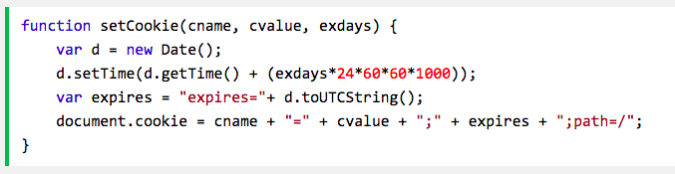
Set a Cookie

Slide 18
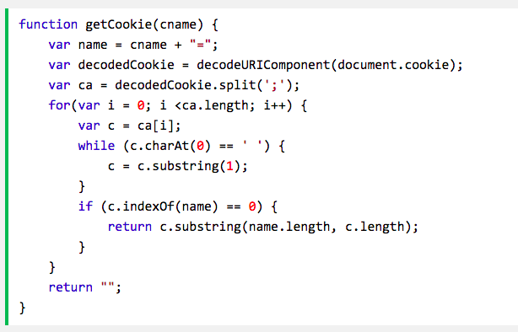
Cookie Retrieval

Slide 19
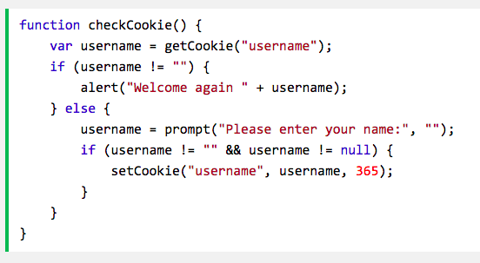
And Output
Let’s put it all together on razor
Notes:
js_cookies.html on razor

Slide 20
Pop Quiz
What happens if I use burp to modify the header and remove the cookie?

Slide 21
The Coolest Javascript Program ever…
Fabrice Bellard…
Wrote qemu, FFmpeg, Tiny C Compiler, won IOCC twice, broke the world record for digits of pi (2.7 trillion places) on a desktop PC, but best of all is his js PC emulator
Can compute pi directly in js as well
Closure version
Bubbles! (and dat.gui)
Freaky head (three.js)
100,000 stars

Slide 22
HTML DOM
Document Object Model
A way of viewing a document as an object
Allows us to manipulate the current document with scripts
Supported by Javascript, Java, VBScript, etc.
We’ve already been using it in the Javascript examples
You can manipulate virtually anything in an HTML document from scripts
Usually via id attribute

Slide 23
Aligning an iframe
<p>This is some text. This is some text. This is some text.
<iframe id="myframe" src=”http://www.cs.colorado.edu/~jrblack">
<p>Your browser does not support iframes.</p>
</iframe>
This is some text. This is some text. This is some text.
<p>
<script type="text/javascript">
document.getElementById("myframe").align="right";
</script>
Notes:
iframe.html on razor

Slide 24
Note: google in an iframe won’t work
Same example with google.com?
Google sets “X-Frame-Options: > SAMEORIGIN”
in a header, preventing it from being embedded in an iframe
Chrome (and virtually every other popular browser) respects this policy

Slide 25
Updating part of an HTML doc
<script type="text/javascript">
function displayDate()
{
document.getElementById("demo").innerHTML=Date();
}
</script>
</head>
<body>
<h1>DOM Demo</h1>
<button type="button" onclick="displayDate()">Display Date</button>
</body>
</html>
Notes:
dom_date.html on moxie

Slide 26
AJAX (Asychronous Javascript And XML)
It’s not a new technology
It’s a collection of existing technologies put together to improve the UX
Basically, Javascript phones home to the server to get updated information, and then (typically) updates the DOM with the result
Google does this as you type your search query
Called “Google Suggest”
Google Maps does this as you’ve probably noticed
It’s used all over these days!

Slide 27
AJAX: The XMLHttpRequest Object
Seeing XMLHttpRequest in javascript means that AJAX is occurring
Typical approach:
var xmlhttp;
if (window.XMLHttpRequest) {
// code for IE7+, Firefox, Chrome, Opera, Safari
xmlhttp=new XMLHttpRequest();
}
else {
// code for IE6, IE5
xmlhttp=new ActiveXObject("Microsoft.XMLHTTP");
}

Slide 28
Querying the Server
Our xmlhttp (declared on previous slide) object has 6 fields: onreadystatechange, readyState, responseText, responseXML, status, statusText
To use, set up an onreadystatechange handler
xmlhttp.onreadystatechange = myhandler;
This handler will be called every time there is a state-change event
xmlhttp.readyState values are 0=uninitialized, 1=loading, 2=loaded, 3=interactive, 4=complete

Slide 29
AJAX Example
function loadXMLDoc()
{
var xmlhttp;
if (window.XMLHttpRequest) xmlhttp=new XMLHttpRequest();
else xmlhttp=new ActiveXObject("Microsoft.XMLHTTP");
xmlhttp.onreadystatechange=function() {
if (xmlhttp.readyState==4 && xmlhttp.status==200)
document.getElementById("myDiv").innerHTML=xmlhttp.responseText;
}
xmlhttp.open("GET", "ajax_info.txt", true);
xmlhttp.send();
}
</script> </head>
<body>
<div id="myDiv"><center><h1>Let AJAX change this text</h1></center></div>
<button type="button" onclick="loadXMLDoc()">Change Content</button>
function is declared inline (called an “anonymous function”)

Slide 30
“Google Suggest” Type Thing
Look at gethint.php and names.html on razor
Note: this is easier using javascript’s “ajax” facility nowadays
jQuery makes this even easier
Normally names would be in a database rather than hardcoded
Often we’d enable a selectable window popup rather than just listing suggestions
This isn’t hard to do

Slide 31
jQuery
jQuery is the most common way to write javascript in 2018
Or rather, to avoid writing as much javascript
jQuery is a javascript library providing support for simple animation, document modification, AJAX, CSS modification, etc
Almost all of the local start-ups want people who know this library
My favorite thing about jQuery is the “minified” version
8000+ lines of javascript converted into one line
Let’s see that in Python!
My second-favorite thing is that the single library call for jQuery is named “$”
Name one use of jQuery you’ve seen in this class already!
Supposedly obsolete in 2020 but still commonly used

Slide 32
Javascript Security
The fundamental security mechanism is the Same Origin Policy
Script A cannot see the DOM of script B unless they come from the same place
Place is defined as domain, protocol, and port
Except IE doesn’t care about port
There have been bugs that allow scripts to violate this policy
Eg, browser bugs
The bigger problem is that the policy is often too restrictive

Slide 33
Work-around for SOP
A script can set document.domain = domain_prefix
So payments.example.com sets to example.com, and www.example.com sets to example.com
But then user-page.example.com can do the same and access variables it perhaps should not!
Some scripts exploit browser bugs to get around this
If above is a problem or if scripts are from different domains
There is no useable mechanism to selectively sandbox and server-based channels are often too slow

Slide 34
In Short: Javascript Security is a Mess
Test description | MSIE6 | MSIE7 | MSIE8 | FF2 | FF3 | Safari | Opera | Chrome | Android
May document.domain be set to TLD alone? | NO | NO | NO | YES | NO | YES | NO | YES | YES
May document.domain be set to TLD with a trailing dot? | YES | YES | NO | YES | NO | YES | NO | YES | YES
May document.domain be set to right-hand IP address fragments? | YES | YES | NO | YES | NO | YES | NO | NO | YES
Do port numbers wrap around in same origin checks? | NO | NO | NO | uint32 | uint32 | uint16/32 | uint16 | NO | n/a
May local HTML access unrelated local files via DOM? | YES | YES | YES | YES | NO | NO | YES | NO | n/a
May local HTML access sites on the Internet via DOM? | NO | NO | NO | NO | NO | NO | NO | NO | n/a

Slide 35
Scripts that mess with scripts
The SOP applies only to protecting a DOM of one script from scripts originating elsewhere
Scripts can still directly affect the running of other scripts
Javascript variables and functions are global
Objects inherit from a global object
Scripts can
Mess with each other’s variables, functions, override native methods, transmit data anywhere, watch keystrokes, steal cookies, etc.
Notes:
clobber.html on moxie

Slide 36
Script Injection
Techcrunch has 18 remotely-loaded Javascript scripts:
mediaplex.com, scorecardresearch.com, quantserve.com, ixnp.com, doubleclick.net, googlesyndicaOon.com, crunchboard.com, snap.com, tweetmeme.com, google-analytics.com
Get your evil script loaded, and you compromise the entire page
DNS tricks used here, usually

Slide 37
AJAX
AJAX has a SOP too
It’s different
Limitations are even worse (we often want to phone not-home)
JSONP was usually used here
Now CORS is the correct solution
There are SOPs for cookies, Flash, Java, Silverlight, Gears, etc
We don’t have time to examine and compare/contrast all of these, but be aware
Client-side security is hard
It’s mostly just broken… GOOD LUCK!

Slide 38
Plug-ins: Some popular ones…
Java Applets
Run in a JVM plug-in
Sandboxed, good performance (JITted)
History of vulnerabilities specific to the security model though
WOEE
ActiveX Controls
Native win32 binaries, executing with full privs of the installing user
Poorly written ActiveX controls have been a common source of vulnerabilities
Flash
Bytecode run in a VM
Scripting is ActionScript (almost the same as Javascript)
PDF
Can run javascript, other exploits possible, often trusted by users

Slide 39
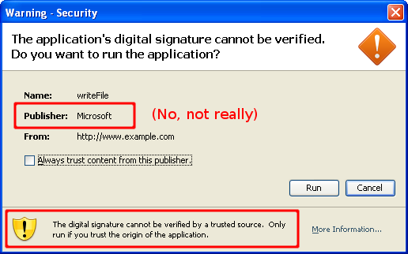
Skylar’s Company’s Fave Drop

